Slide 1

Early Leaf Disease prediction in Paddy Crop using Deep Learning Models
Madan Mohan Malaviya University Of Technology , Gorakhpur
(Mini-Project)
(Mohini Tyagi)

Slide 2
Outline
Problem Statement
Motivation
Objective
Literature Review
Approach
Methodology
Result
Conclusion & Future Scope
References

Slide 3
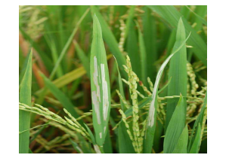
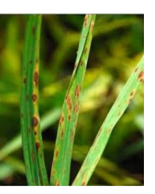
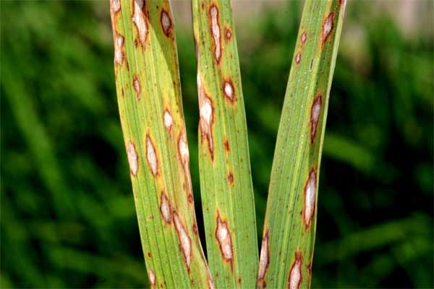
Problem Statement
Paddy Plant Disease:-
There are various diseases that are affecting the Paddy plant due to which productivity of the crop gets reduced. Some of them are listed below.
Rice blast Hispa Brown Spot
Elliptical in shape
5-10% losses, 40-45% in Phillipines
Attacks on Root, stem, leaf, neck.
Round or oval in shape.
Upto 45 % losses.
Infect in high humidity of more than 80 % and temperature(16-34).
White streaks in parallel to mid leaf
Upto 20% losses.
Bangladesh is the most affected.

Slide 4
Motivation
Rice is one of the most important and Common crop in the Agriculture in India.
As per the report of the Ministry of Statistics Programme Implementation, the Agricultural sector contributes about 20.19% to the Indian GDP.
India is the Second largest Producer of Rice in the World.
Farmers loose about 37% of their crop due to the it’s disease.[1]
Hence, it is necessary to detect the diseases in the early stage so that proper treatment can be given and crop losses can be minimized.

Slide 5
Objective
Here, Objective is to create an efficient & automated model using Deep learning techniques that can easily detect the rice crop diseases. It will be cost-efficient & less time- consuming process.

Slide 6
Literature Review
S. No. | Paper | Methodology
1 | A Survey Paper on Plant Disease detection identification implementation Using Flutter App (Sarvesh Sharma et al.) | Image was collected from the field & preprocessed to remove unwanted features. Features were extracted through the segment portion. Algorithms used for Classifications are KNN, SVM, ANN
2 | Paddy Plant Disease Detection Using Image Processing (Goh Chin Yeh et al.) | 11 features were extracted using K- means Clustering. Classification was done by using Random Forest Classifier technique.

Slide 7
S. No. | Paper | Methodology
3 | "Rice disease classification using supervised machine learning approach" (Kalyan Kumar Jena et al.[8]) | Supervised learning. KNN, SVM, Decision tree, and Random Forest have been used for classfications. Hispa, BrownSpot, Healthy & LeafBlast have been classified using this mode
4 | Identifying the paddy crop disease in mobile app using image processing and Machine learning techniques" ( BS Puttaswamy, et al.) | Method used- CNN four disease i,e. Bacterial blight, Brown spot, Blast, and Tungaro.

Slide 8
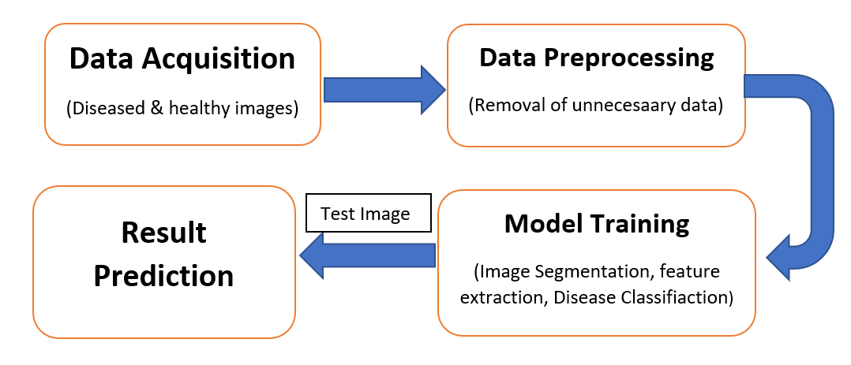
Approach

Slide 9
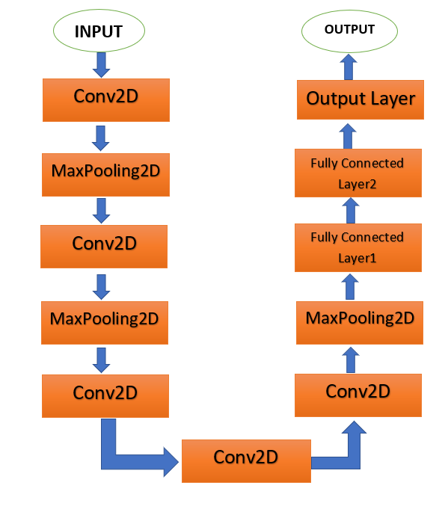
Methodology
Three models i.e. VGG16, ResNet101, Alexnet have been used in this project out of which Alexnet has the highest accuracy. So we have taken AlexNet Architecture for disease classification.

Slide 10
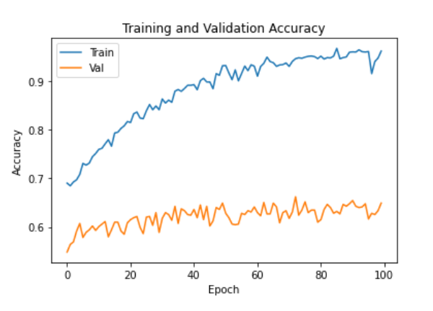
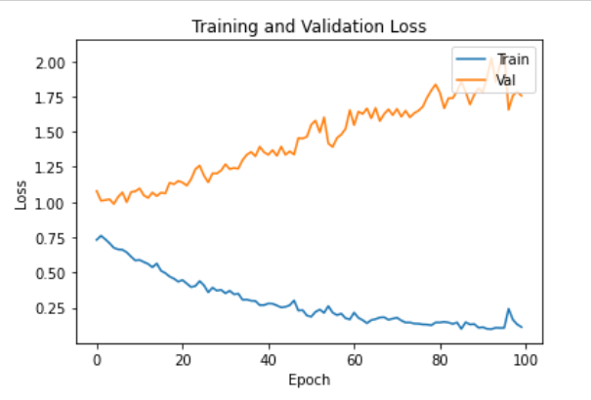
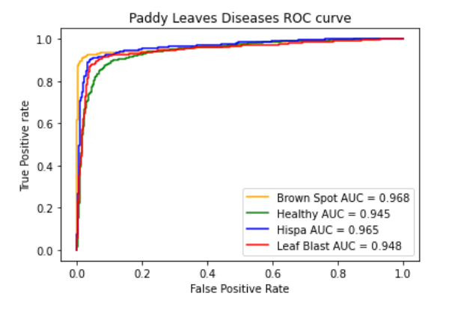
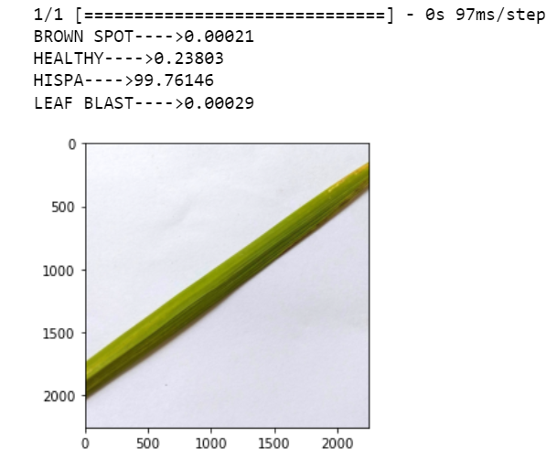
Result
Graph of Accuracy v/s Epochs Graph of Loss v/s Epochs
ROC Curve Result Prediction

Slide 11
Conclusion & Future Scope
Our model has been trained using 3 models i,e VGG16, ResNet101, &Alexnet architecture .
Four classes have been successfully classified in this paper (Brown spot, Leaf blast, Hispa & Healthy Images).
Learning is a continuous process so these convolutional neural network models should be updated to enable them to classify more classes of disease.

Slide 12
References
[1] AFA Ahmad Effendi, Md Isa, MI Ahmad, MF Che Husin, and SZ Md Naziri. Image processing for paddy disease detection using k-means clustering and glcm algorithm. International Journal of Nanoelectronics & Materials, 14, 2021. [2] Kawcher Ahmed, Tasmia Rahman Shahidi, Syed Md Irfanul Alam, and Sifat Momen. Rice leaf disease detection using machine learning tech- niques. In 2019 International Conference on Sustainable Technologies for Industry 4.0 (STI), pages 1–5. IEEE, 2019. [3] Majji V Applalanaidu and G Kumaravelan. A review of machine learning approaches in plant leaf disease detection and classification. In 2021 Third International Conference on Intelligent Communication Technologies and Virtual Mobile Networks (ICICV), pages 716–724. IEEE, 2021. [4] PA Gunawan, EN Kencana, and K Sari. Classification of rice leaf dis- eases using artificial neural network. In Journal of Physics: Conference Series, volume 1722, page 012013. IOP Publishing, 2021.

Slide 13
[5] Jianrong Huang, Huaijian Liao, Yubo Zhu, Jiayi Sun, Qihua Sun, and Xiangdong Liu. Hyperspectral detection of rice damaged by rice leaf folder (cnaphalocrocis medinalis). Computers and electronics in agriculture, 82:100–107, 2012. [6] Md Ashiqul Islam, Md Nymur Rahman Shuvo, Muhammad Shamso- jjaman, Shazid Hasan, Md Shahadat Hossain, and Tania Khatun. An automated convolutional neural network based approach for paddy leaf disease detection. International Journal of Advanced Computer Science and Applications, 12(1), 2021.
[7] Kalyan Kumar Jena, Sourav Kumar Bhoi, Debasis Mohapatra, Chit- taranjan Mallick, and Prachi Swain. Rice disease classification using supervised machine learning approach. In 2021 Fifth International Conference on I-SMAC (IoT in Social, Mobile, Analytics and Cloud)(I- SMAC), pages 328–333. IEEE, 2021. [18] Kalpesh Joshi, Rohan Awale, Sara Ahmad, Sanmit Patil, and Vipul Pisal. Plant leaf disease detection using computer vision techniques and machine learning. In ITM Web of Conferences, volume 44, page 03002. EDP Sciences, 2022. [9] Sachin D Khirade and AB Patil. Plant disease detection using image processing. In 2015 International conference on computing communi- cation control and automation, pages 768–771. IEEE, 2015.

Slide 14
[10] Ghazanfar Latif, Sherif E Abdelhamid, Roxane Elias Mallouhy, Jaafar Alghazo, and Zafar Abbas Kazimi. Deep learning utilization in agri- culture: Detection of rice plant diseases using an improved cnn model. Plants, 11(17):2230, 2022. [11] Sourabrata Mukherjee. t-sne based feature extraction technique for multi-layer perceptron neural network classifier. In 2017 International Conference on Intelligent Computing, Instrumentation and Control Tech- nologies (ICICICT), pages 660–664. IEEE, 2017. [12] Pooja Pawar, Varsha Turkar, and Pravin Patil. Cucumber disease detec- tion using artificial neural network. In 2016 international conference on inventive computation technologies (ICICT), volume 3, pages 1–5. IEEE, 2016. [13] Harshadkumar B Prajapati, Jitesh P Shah, and Vipul K Dabhi. Detection and classification of rice plant diseases. Intelligent Decision Technolo- gies, 11(3):357–373, 2017. [14] BS PrajwalGowda, MA Nisarga, M Rachana, S Shashank, and BS Sa- hana Raj. Paddy crop disease detection using machine learning. International Journal of Engineering Research & Technology, 8(13), 2020. [15] R Meena Prakash, GP Saraswathy, G Ramalakshmi, KH Mangaleswari, and T Kaviya. Detection of leaf diseases and classification using digital image processing. In 2017 international conference on innovations in information, embedded and communication systems (ICIIECS), pages 1–4. IEEE, 2017.

Slide 15
[16] BS Puttaswamy, SM Bramesh, Nithin Bharadwaj, Sudeep HS, Noothan Dev SL, and M Shashanka. Identifying the paddy crop disease in mobile app using image processing and machine learning techniques. [17] Shampa Sengupta and Asit K Das. Particle swarm optimization based incremental classifier design for rice disease prediction. Computers and Electronics in Agriculture, 140:443–451, 2017. [18] Ian Sequeira, Shreya Shah, Sharmila Sengupta, Etisha Mathurvaishya, Chinmay Waykole, and KS Raghuwanshi. Agricare: To detect and prevent paddy crop diseases using machine learning. Available at SSRN 4108881, 2022. [19] Sarvesh Sharma, Meghna Pandey, Jay Singh Talreja, and Heena Raj. A survey paper on plant disease detection identification implementation using flutter app. [20] Vikas Sharma, Aftab Ahmad Mir, and Abid Sarwr. Detection of rice disease using bayes’ classifier and minimum distance classifier. Journal of Multimedia Information System, 7(1):17–24, 2020. [21] Pallapothala Tejaswini, Priyanshi Singh, Monica Ramchandani, Yo- gesh Kumar Rathore, and Rekh Ram Janghel. Rice leaf disease classi- fication using cnn. In IOP Conference Series: Earth and Environmental Science, volume 1032, page 012017. IOP Publishing, 2022.

Slide 16
THANKYOU!

